Slide 1



Pharmacy DB
Supervisors:
Dr/ Asmaa Saad
Eng/ Ahmed Abdelsalam

Slide 2
Team members :
Eng/ Mohamed Ashraf Omara
Eng/ Salma Yasser Mostafa
Eng/ wafaa gamal okasha
Eng/ ola farhat ibrahim

Slide 3
Agenda
Problem definition
Introduction
ERD
Schema
Relationships
Tables
Forms
Reports

Slide 4
Problem definition
We Want to develop Pharmacy Management Project Using MS Access ,pharmacy consists of Customers , Employees , Products and Invoices
• Customer data is recorded in the pharmacy management system, such as name, address, phone number, date of birth, and the initial date of the pharmacy visit.
• Employee data is recorded in the pharmacy, such as name, position, salary, employment history, and tasks assigned to each employee.

Slide 5
Problem definition
• Invoices are issued to customers when purchasing medicines , and the invoice includes details of the purchased products, price, taxes, and total cost.
• Product data is recorded in the pharmacy, such as name, price, units, manufacturing date, expiry date, and supplier information.
• Sales data is recorded in the pharmacy, such as the date of sale, products purchased, sale quantity, price, and total amount.

Slide 6
In our system can make forms, query and generate report.
Relationship between employees and invoices is (1: m)
Relationship between customers and invoices is (1: m)
Relationship between customers and products is (m: n)
Relationship between invoices and products is (m: n)
The pharmacy management system can be used to analyze customer, employee, billing, product and sales data, improve pharmacy services and identify the most effective methods to increase sales and improve customer experience. It can also be used to analyze and evaluate employee performance to improve service quality, identify inventory needs and better introduce new and desired products to the market.

Slide 7
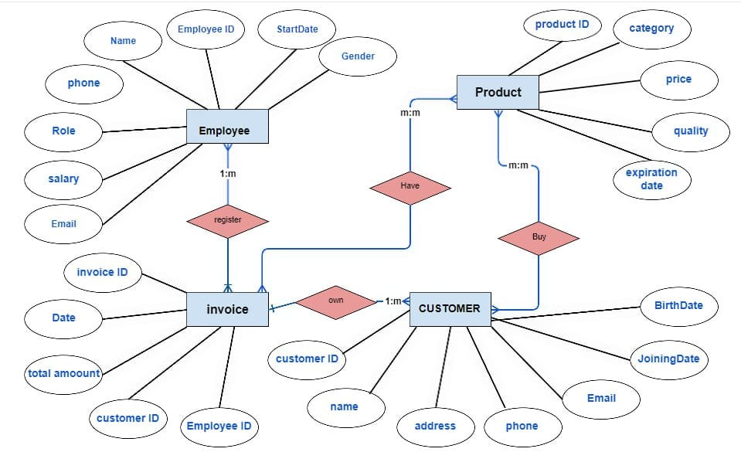
ERD

Slide 8
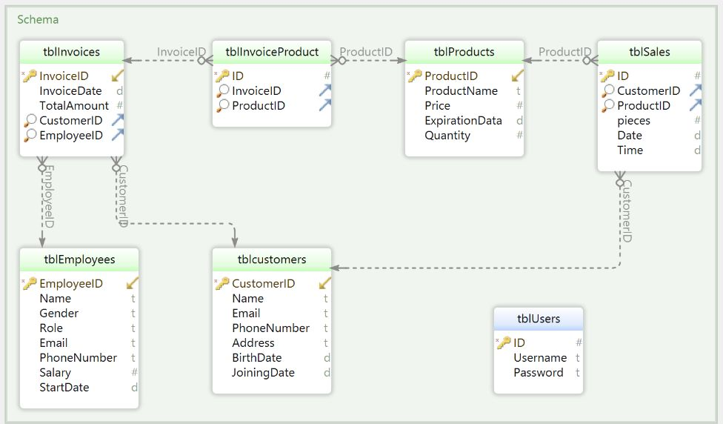
Schema:

Slide 9
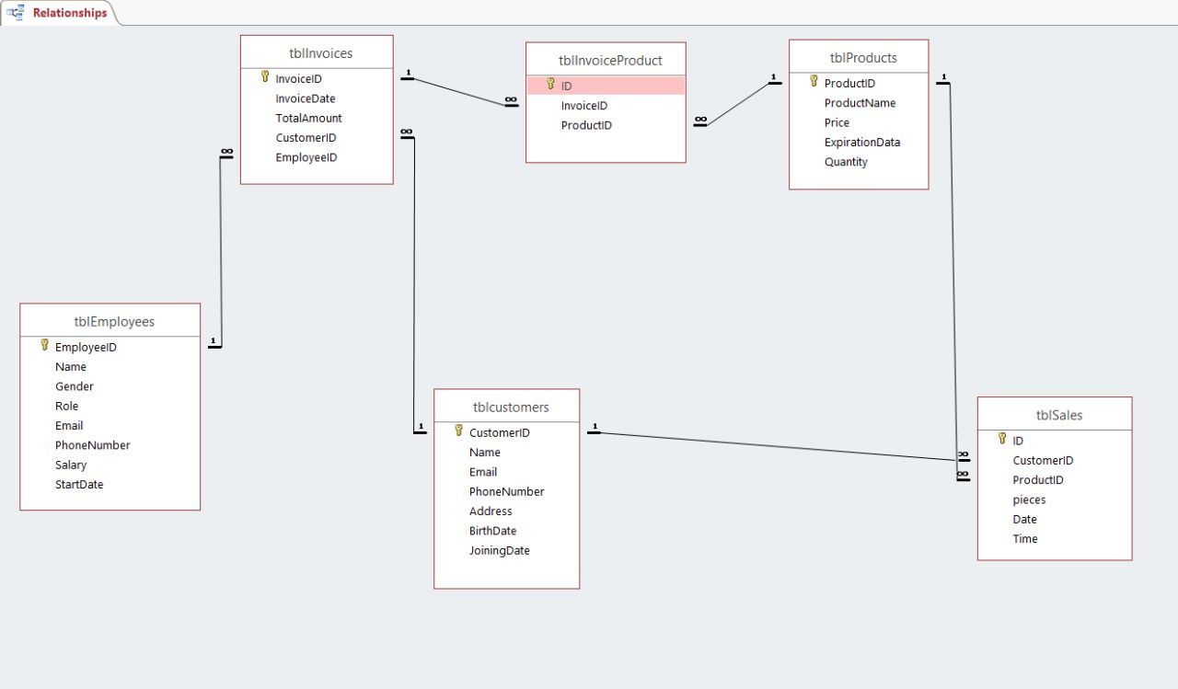
Relationships :

Slide 10
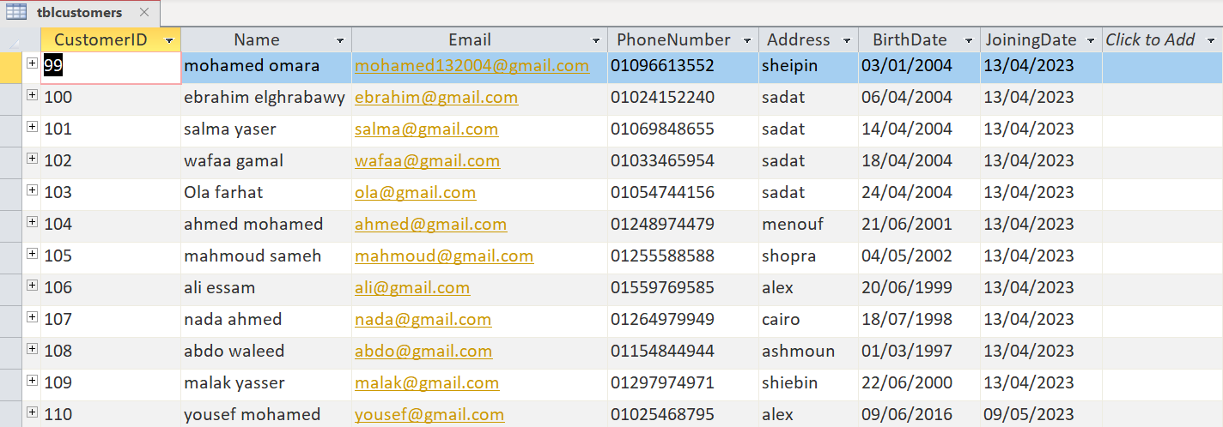
Tables:

Slide 11
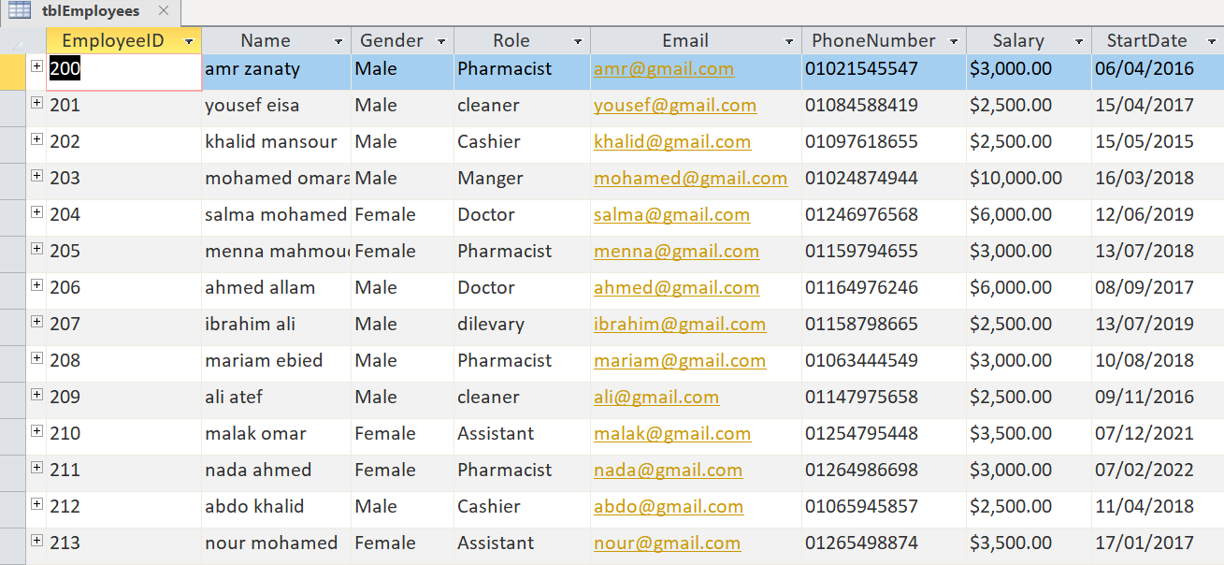
Tables:

Slide 12
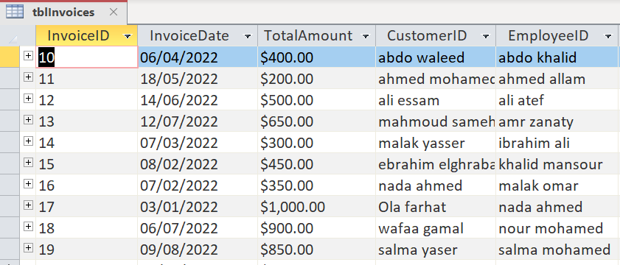
Tables:

Slide 13
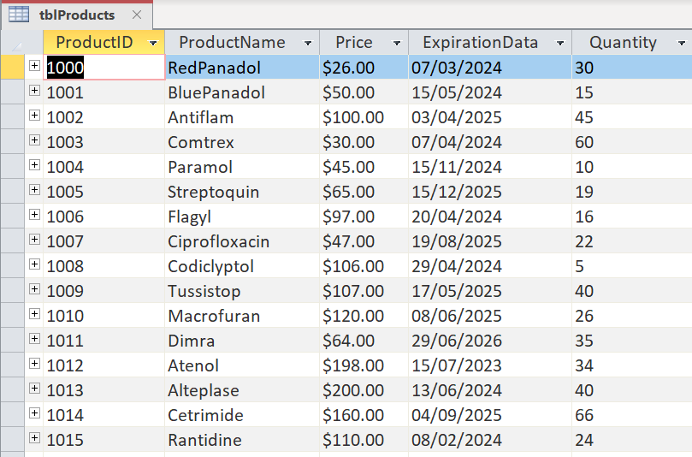
Tables:

Slide 14
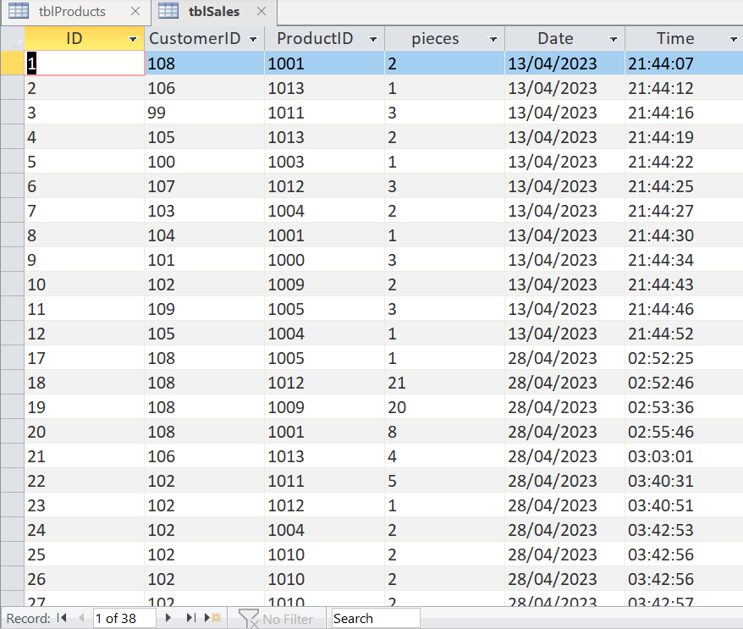
Tables:

Slide 15
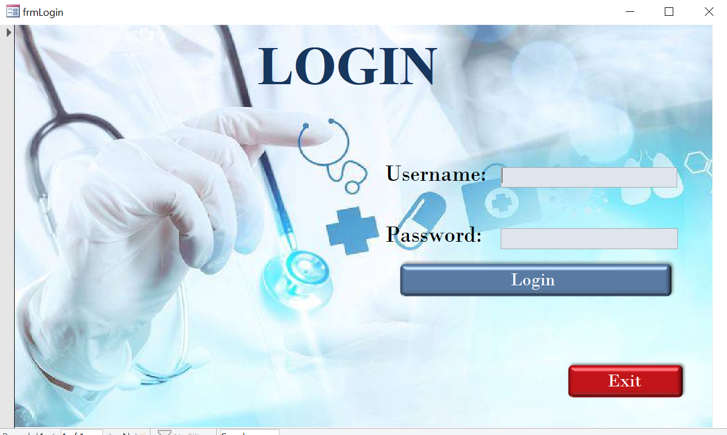
Forms :

Slide 16
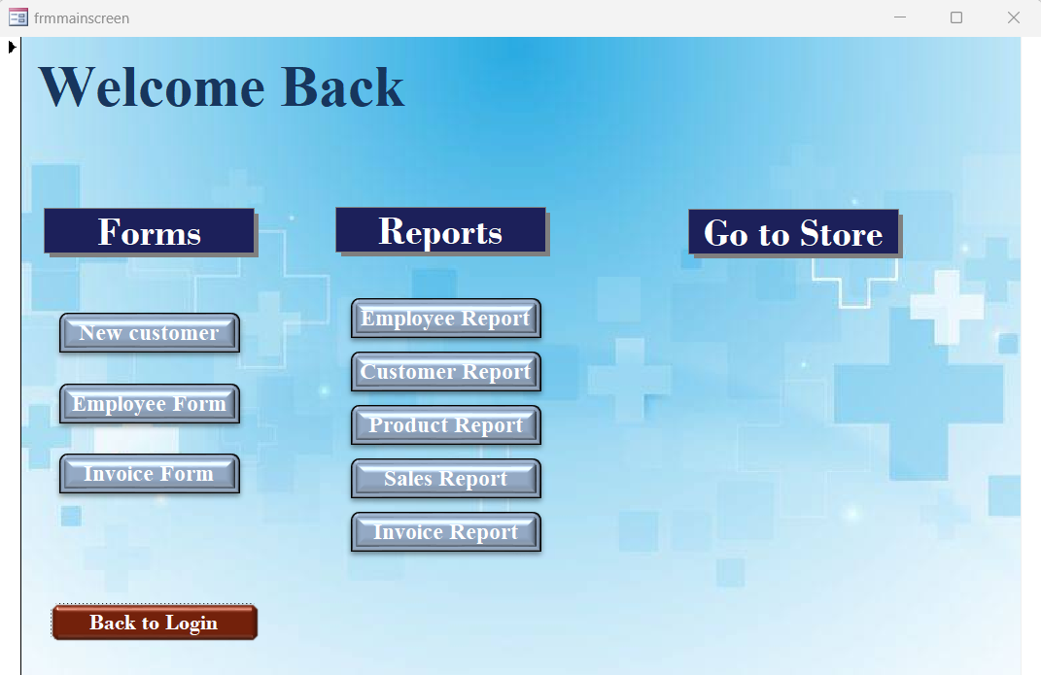
Forms :

Slide 17
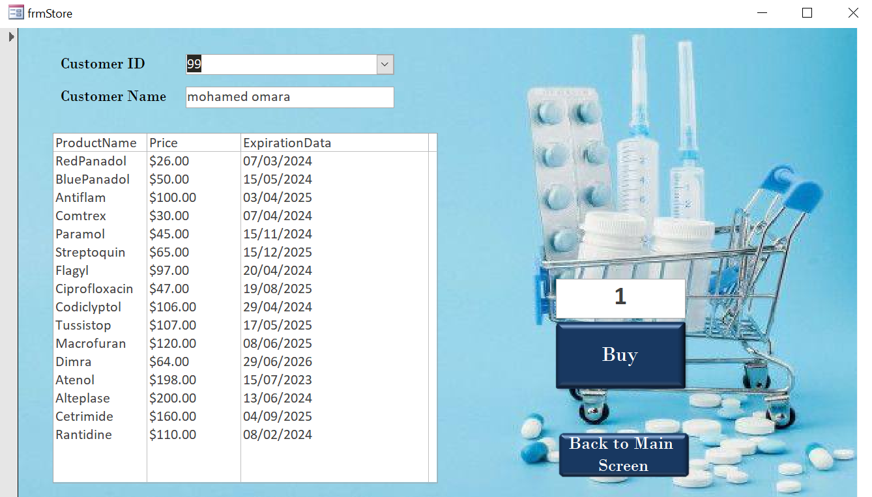
Forms :

Slide 18
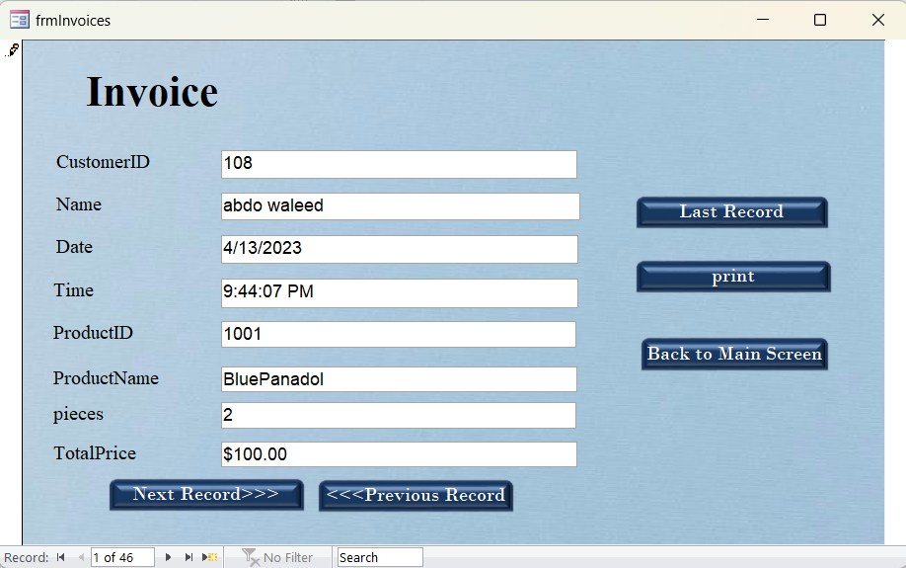
Forms :

Slide 19
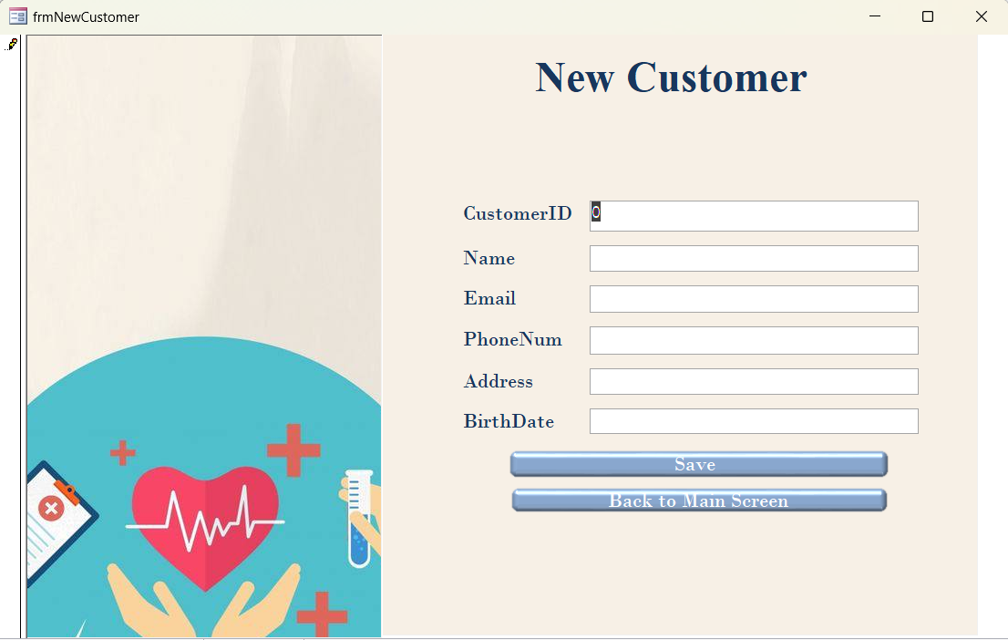
Forms :

Slide 20
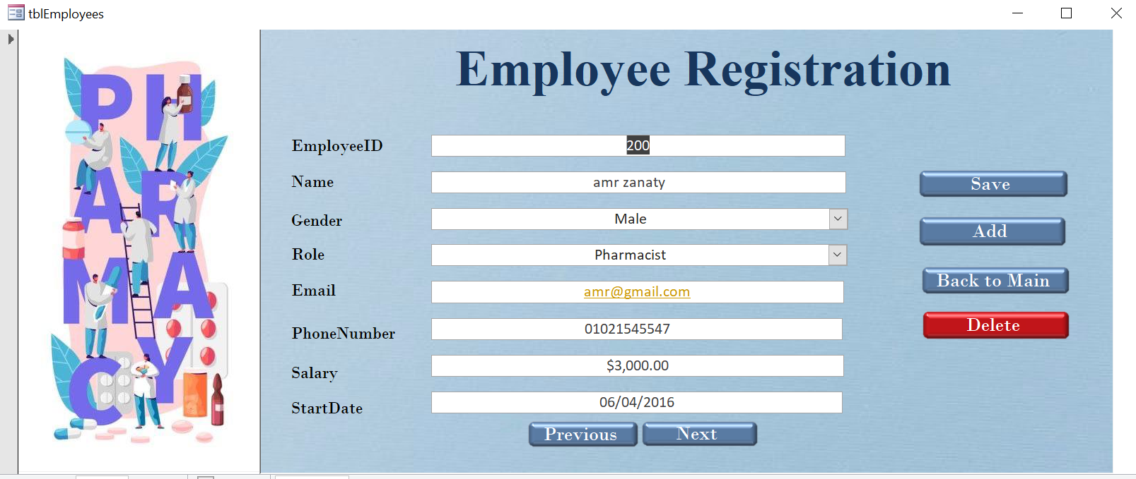
Forms :

Slide 21
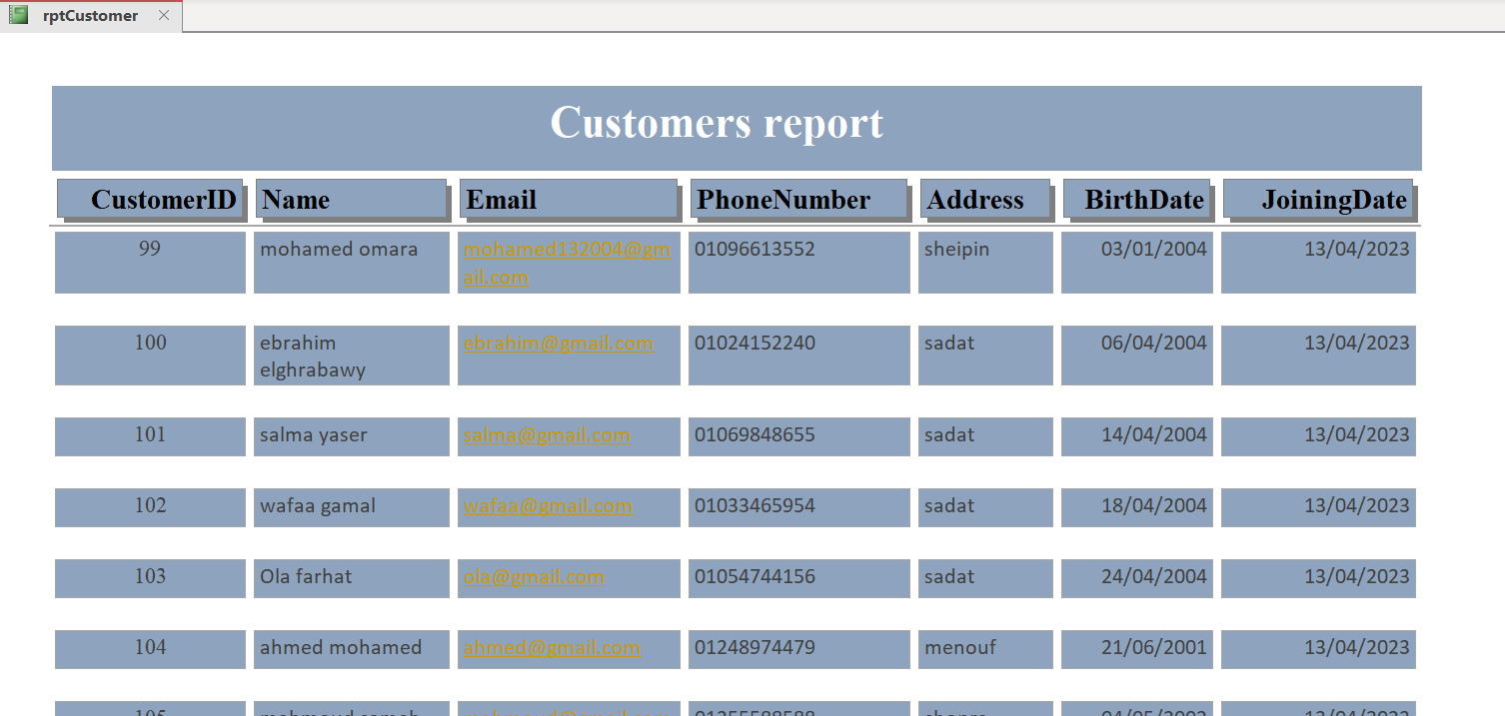
Reports :

Slide 22
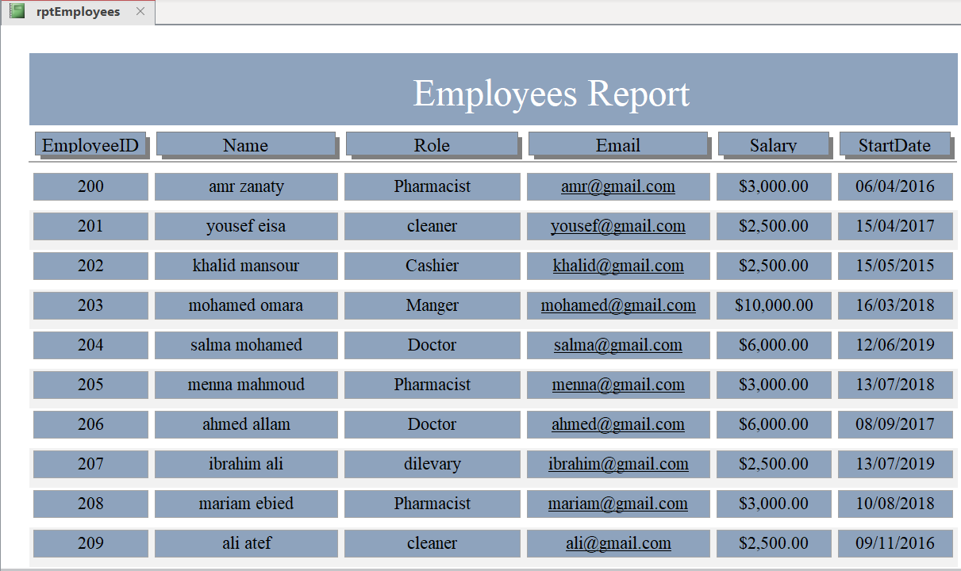
Reports :

Slide 23
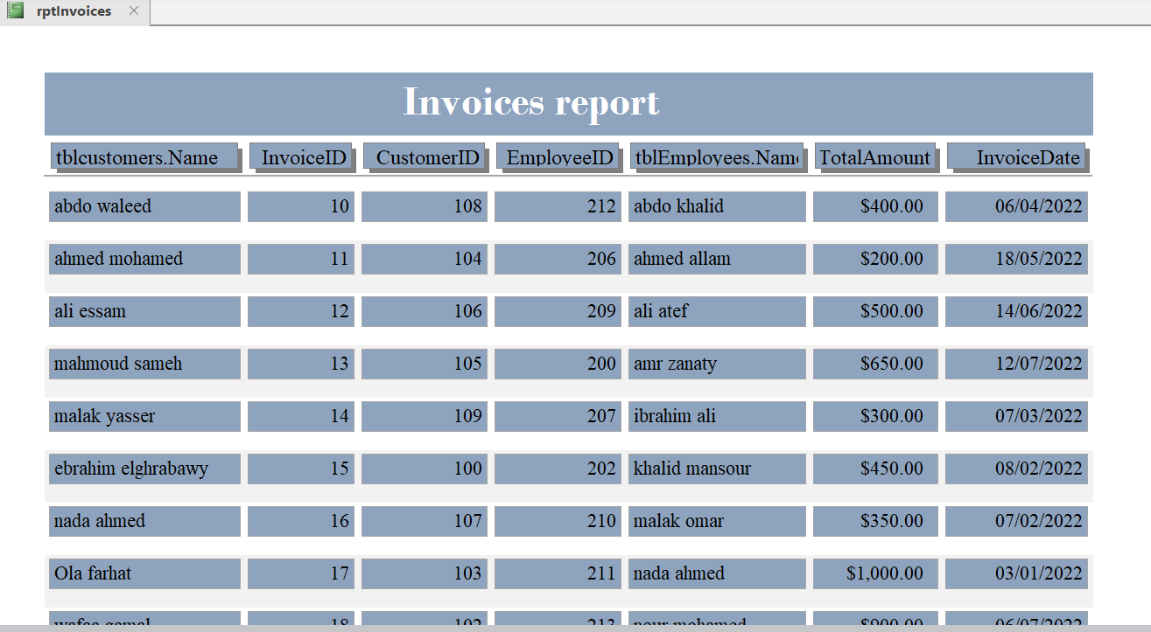
Reports :

Slide 24
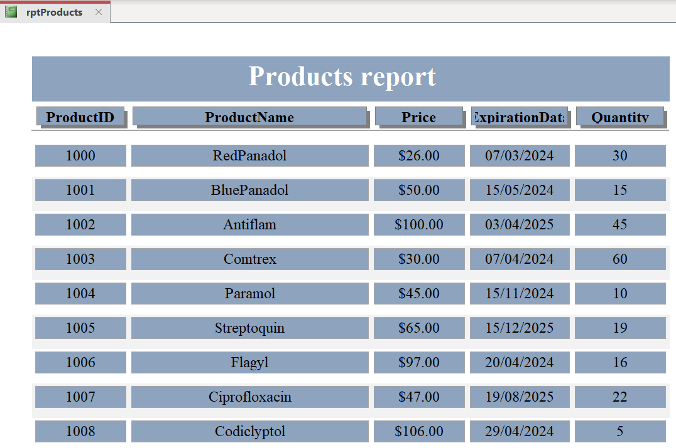
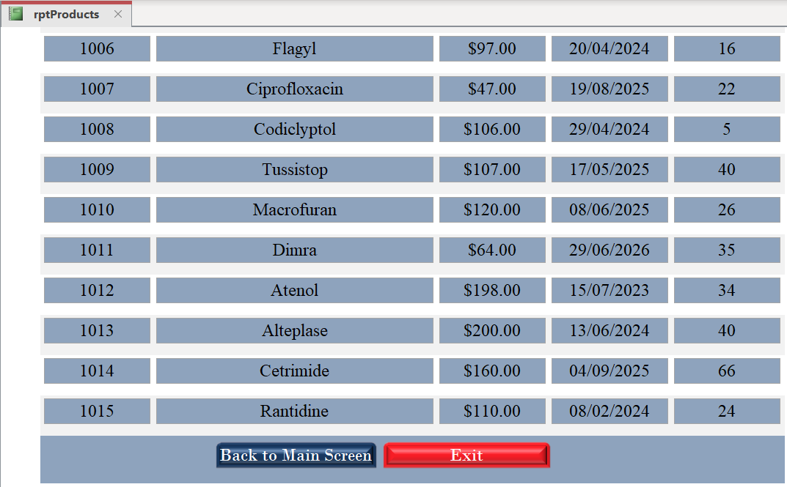
Reports :

Slide 25
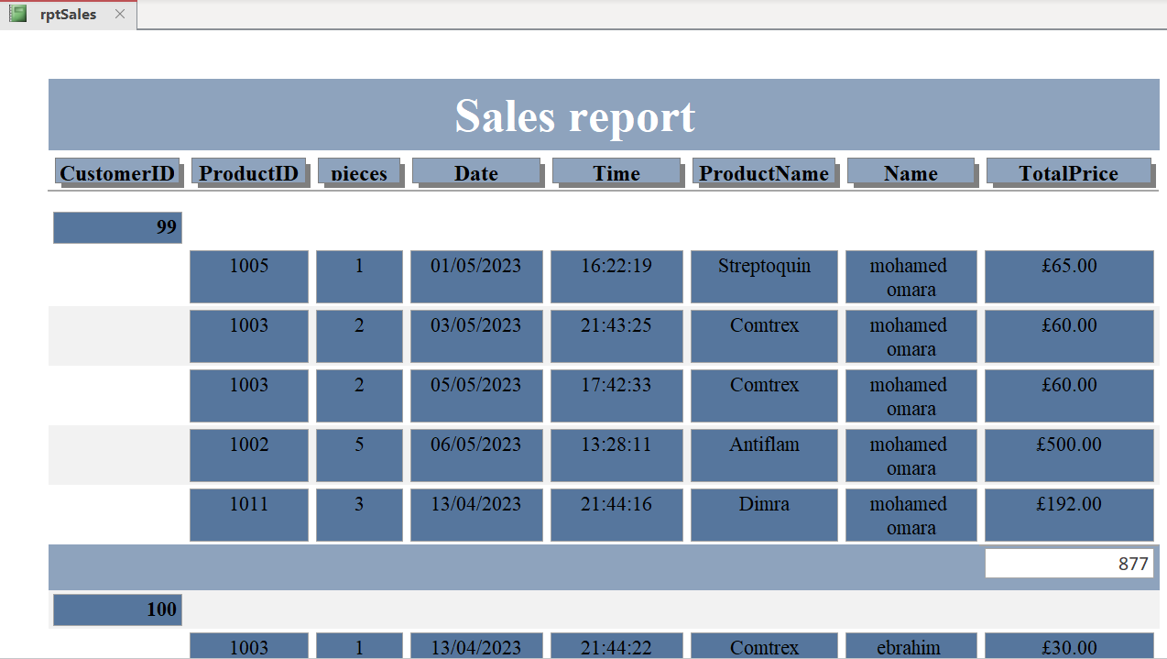
Reports :

Slide 26
THANK YOU

